Slide 1

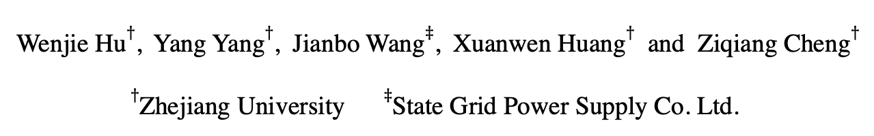
Understanding Electricity-Theft Behavior via Multi-Source Data
Paper ID: 2086
Wenjie Hu$†$, Yang Yang$†$, Jianbo Wang$‡$, Xuanwen Huang$†$ and Ziqiang Cheng$†$
$†$Zhejiang University $‡$State Grid Power Supply Co. Ltd.
Notes:
Hello everyone, I am Wenjie Hu from Zhejiang University. I am happy to be here to share with you about our recent work on electricity-theft detection via multi-source data. It is a joint work with my advisor Yang, jianbo from State Grid of China, xuanwen and ziqiang are also from Zhejiang university

Slide 2
Background
Electricity theft is a common illegal behavior in developing countries.
In 2012, GDP in India was reported to drop 1.5% as a result of electricity theft^{[1]};
In 2010, State Grid of China lost 6.1% of its total electric power.
[1] PR Newswire. 2017. 96 Billion Is Lost Every Year To Electricity Theft: Utilities increasingly investing in solutions to combat theft and non-technical losses.
Notes:
When we talk about electricity theft, it is a behavior that users conduct illegal operations to avoid electricity bills, becoming a common phenomenon in the developing countries. As a statistic shown in 2012, GDP in India was reported to drop 1.5% as a result of electricity theft, while Uttar Pradesh, the most populous state in India, lost 36% of its total electric power to theft of this kind. These behaviors not only result in unbearable economic losses to the power suppliers, but also endangers the safety of users, systems, and even the public at large. Great efforts have been made to detect and prevent electricity theft.

Slide 3
Background
Hardware-driven Methods^{[2]}:
upgrade the meter structures;
install a centralized;
fully closed meter box.
Drawbacks:
require expert domain knowledge;
hard to design a general structure, due to the various pilfering tactics;
effectiveness loss once thieves change their tactics.
[2] Li-Cai Guo, Zhi-Wei Peng, and Qiang Fan. 2010. A survey of electric energy metering and countermeasures to electric power stealing [J]. High Voltage Apparatus 46, 5 (2010), 86–88.
Notes:
The most intuitive way is hardware-driven methods. In short, we try to find out how the thieves pilfer the power, then design and upgrade the meter structures accordingly, such as installing a centralized or fully closed meter box for residents.
However, there are three major drawbacks of these hardware-driven methods: first, they require domain knowledge to specify the techniques that the thieves use; second, it is difficult to design a general meter structure, as the different pilfering tactics; third, their effectiveness will lose once thieves change their tactics.

Slide 4
Background
Data-driven Methods^{[3, 4]}:
analyze electricity usage records of each user;
analyze NTL^{[5]} records;
Non-Technical Loss (NTL): the energy that is distributed but not billed;
Statistics are generally made in units of area (e.g., community, village, etc.).
Drawbacks:
heavy burden for artificial analysis due to the massive data;
few labels for model learning;
isolated model and fail to obtain good performance.
Goal: Identify electricity-theives via multi-source data in a hierarchical view.
[3] ZibinZheng,YataoYang,XiangdongNiu,Hong-NingDai,andYurenZhou.2017. Wide and deep convolutional neural networks for electricity-theft detection to secure smart grids. IEEE Transactions on Industrial Informatics,
[4] SomaShekaraSreenadhReddyDepuru,LingfengWang,andVijayDevabhaktuni. 2011. Support vector machine based data classification for detection of electricity theft. In Power Systems Conference and Exposition (PES). IEEE, 1–8.
[5] Abhishek Chauhan and Saurabh Rajvanshi. 2013. Non-technical losses in power system: A review. In International Conference on Power, Energy and Control (ICPEC). IEEE, 558–561.
Notes:
To address these problems, data-driven methods have been applied to electricity-theft detection. Many suppliers collect users’ electricity records and analyze their behaviors. Some works also take NTL into consideration. Non-technical loss (NTL) is defined as the energy that is distributed but not billed; in other words, this type of loss is caused by issues in the meter-to-cash processes，which are generally collected in units of area (such as community, village, and so on). However, most of these methods have failed to obtain good performance, due to the few labels and irregularity of user behaviors, which is almost impossible to fully understand either using NTL or usage records alone.
Therefore, in our work, we aim to recognize electricity-theft behavior by bridging multi-source data in a hierarchical view.

Slide 5
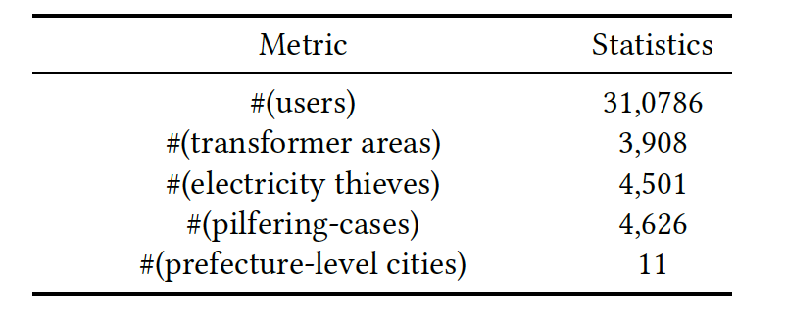
Hierarchical Structure of Power Grid Data
Data：(~2 years, from June 2017 to April 2019)
310,786 electricity usage records of user,
3,908 NTL records of transformer areas,
11 weather records of prefecture-level cities.
1.45%
Macro-level:
How does these information reveal
electricity-theft behaviors together?
Meso-level:
Micro-level:
Notes:
We get the data from State Grid of Zhejiang, China and Weather Radar cross around 2 years, including around 3 millions user’s records, 3 thousands NTL records and weather records of 11 cities. In these data, around 4 thousands cases were confirmed by the staff to be electricity thieves during their on-site investigations, accounted for 1.45%. We take these cases as ground-truth for detailed analysis. So the question is, how do we utilize these multi-source information to detect electricity theft? Intuitively, we propose to build three-level structure.

Slide 6
Observation in Micro-Level (User)
Different pricing electricity (wiki: https://en.wikipedia.org/wiki/Electricity_pricing)
when the thief was caught
Usage variations before and after on-site checking：
The weather gets cooler from Jul. to Oct.
Thieves
Normal
users
The slope of normal user tends to be negative, while half of thieves have a positive one.
1. Significant increment after being caught;
2. Normal users consume less power and perform stable.
Electricity thieves have a higher level of power consumption with less stability.
Notes:
We first examine the micro-level information. As shown in the picture, we draw the daily on-peak and off-peak electricity of the user. Red bar indicate the time when the thief was caught. We can see that the recorded usage increases after being caught. In light of the above observation, we provide an overview of the electricity consumption of both electricity thieves and normal users. We draw the distributions of daily usage before and after being caught.
We can clearly see that for electricity thieves, there is a significant increment of usage after being caught compared with before, while the normal users seems unchanged, and consume less power and perform stable. We can find that users whose electricity consumption is high are expected to have a far stronger motivation to steal power.
Next, to further illustrate the differences between thieves and normal user, we conduct a linear regression on usage from July to October, before the theft was identified. We can see the slope of normal user tends to be negative, while half of thieves have a positive one.

Slide 7
Observation in Meso-Level (Area)
when the thief was caught
1. The less usage, the higher the NTL;
2. After on-site checking, the NTL became stable.
Normal users perform stable and regular.
Usage increases and NTL drops after being caught.
NTL is a signal for electricity theft.
Notes:
Then, we examine the meso-level information. Although we can observe several differences between electricity thieves and normal users in terms of personal usage, but it is inefficient due to the complicated user behaviors. So we take NTL into consideration. As shown in the picture, we can see when the user is recorded low usage, the non-technical loss in the corresponding area is high. After being caught, the NTL of the area became stable.
From the statistic of all users，electricity usage of normal users are rather stable during the observed timespan; but thieves‘ consumption significantly increased once they were caught, while the NTL of transformer areas dropped accordingly. It gives us the clue that the NTL can be a signal for indicating whether there are electricity thieves in this area.

Slide 8
Observation in Macro-Level (Climate)
Statistics: the number of electricity thieves in each month
Summer
Winter
Climatic conditions would influence the user behavior of electricity usage (e.g., the usage of the air conditioner, heaters, etc.) and lead people to pilfer electricity.
The correlations between temperature and total electricity usage
Temperature is able to guide user behaviors
of electricity usage
Increased electricity with the high temperature
Increased electricity with the low temperature
Notes:
Some previous works explored the influence of climate on user behavior, such as taxi ordering. Here, we present the statistics of the seasonal effects on electricity theft. As shown in figure, most pilfering cases were caught in summer and winter, illustrating that climatic conditions would influence the user behavior of electricity usage, such as the usage of the air conditioner, heaters,.. and lead people to pilfer electricity.
In order to illustrate the correlation between temperature and users‘ usage, we compare the averaged daily consumption of all users and daily temperature over one year. We can observe that the usage fluctuates with the temperature, as some sharp peaks and valleys are coincident. The most obvious correlations is that high or low temperatures are associated with increased consumption, illustrating that temperature is able to guide user behaviors of electricity usage.

Slide 9
Observation in Macro-Level (Climate)
Wasserstein distance
The scatterplot of normal users is well fitted to a specific quadratic curve;
The scatterplot of electricity thieves seems disordered and irregular.
The gap between thieves and normal users is larger under extremely high or low temperatures
Notes:
We aggregate the daily usage based on the temperature of that day, then draw a boxplot with respect to electricity thieves and normal users. We use Wasserstein distance to present the dissimilarity between two distribution. We find that the gap of daily usage between thieves and normal users is significantly larger under high or low temperatures compared with average temperatures.
We also choose a typical thief along with a normal user in the same area as examples, then show the scatterplot of daily electricity and temperature in the form of 2-D figures. Again, the trends of the normal user is consistent with our experience, suggesting that very high or low temperatures are associated with elevated consumption; by contrast, the scatterplot of the electricity thief seems disordered and irregular. We conduct statistics to validate this assumption

Slide 10
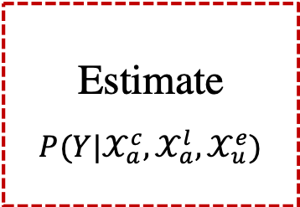
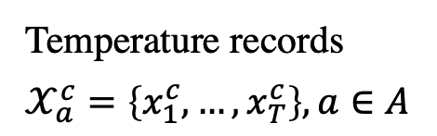
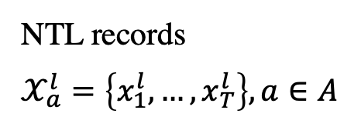
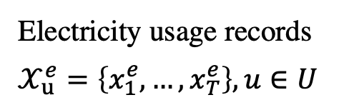
HEBR: Hierarchical Electricity-theft Behavior Recognition
HEBR aims to bridge the information from different sources and capture their hierarchical correlations when detecting electricity theft.
Temperature records
$$𝒳_{a}^{c}=\left\{x_{1}^{c},…,x_{T}^{c}\right\},a∈A$$
Macro-level:
Estimate
$${P(Y|𝒳}_{a}^{c},𝒳_{a}^{l},𝒳_{u}^{e})$$
NTL records
$$𝒳_{a}^{l}=\left\{x_{1}^{l},…,x_{T}^{l}\right\}, a∈A$$
Meso-level:
Electricity usage records
$$𝒳_{u}^{e}=\left\{x_{1}^{e},…,x_{T}^{e}\right\}, u∈U$$
Micro-level:
Notes:
So far， we can conclude that the analysis based on the combination of power usage, NTL and temperature can yield extra information related to the electricity-theft behavior. Here, we integrate the insights into a hierarchical framework, named HEBR. HEBR aims to bridge the information from different sources and capture their hierarchical correlations when detecting electricity theft. It consider three distinct levels of information, and try to estimate the probability of a user being thief.

Slide 11
HEBR: Hierarchical Electricity-theft Behavior Recognition
HEBR contains three levels of feature extraction and hierarchical fusion
model the influence from macro/meso to micro info.
uniform the influence from macro and meso level.
estimate the probability of electricity theft.
Notes:
It is the Architecture of HEBR. Given a multi-source observation sequence, HEBR constructs a three-level framework: at each level, different sequences are inputted into different recurrent layers respectively, the latent representations of which are fused in pairs.
Different levels have different targets. Level 1 aim s to capture the influence from macro-
or meso-level factors on user behaviors respectively. Level 2 try to uniform the influence from macro and meso level, and Level 3 aims to output the probability of electricity theft.

Slide 12
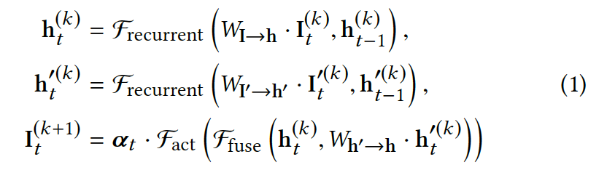
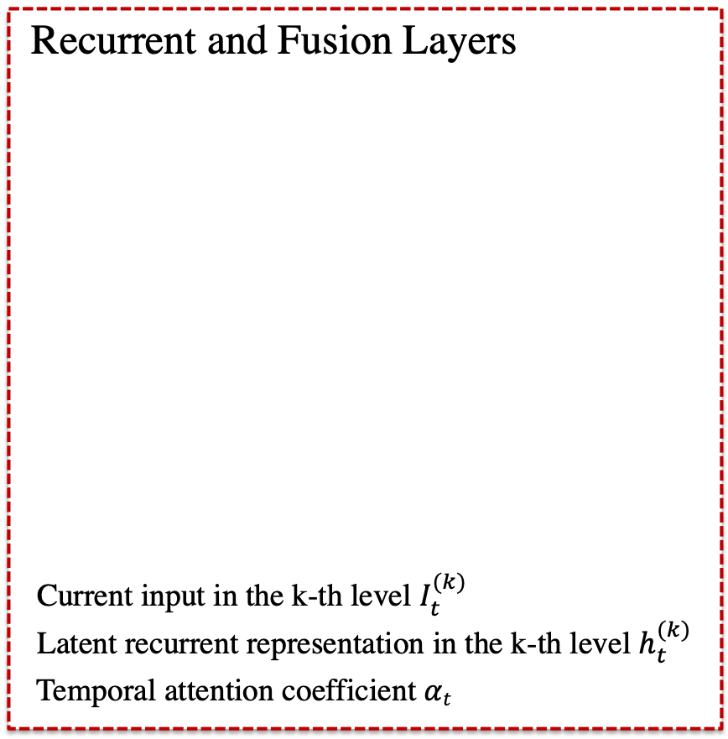
HEBR: Hierarchical Electricity-theft Behavior Recognition
Recurrent and Fusion Layers
Current input in the k-th level $I_{t}^{(k)}$
Latent recurrent representation in the k-th level $h_{t}^{(k)}$
Temporal attention coefficient $αt$
Notes:
As for the operations in each level, there are two important layers for feature extraction and fusion: recurrent layer and fusion layer. Formulations are as follows. H and apostrophe h are latent representation of current input I. alpha denotes the temporal attention coefficient, which tries to automatically discover the attention weights based on “end-to-end” learning.

Slide 13
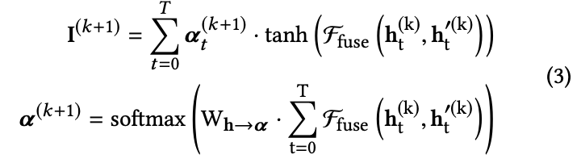
HEBR: Hierarchical Electricity-theft Behavior Recognition
Multi-step fusion mechanism
Temporal attention highlight the significance of the fused information at different time step:
Notes:
In real life, we can usually observe that if the previous day was very hot, people will tend to turn on the air conditioner for a longer time, even if today is colder. In other words, there may be time-delayed existed among the different source data. So, in order to capture more information, we design a multi-step fusion mechanism, as shown in equation 2. It try to fuse more information in the temporal interval rather than just at the current temporal point.
However, it is impossible that the fused information at each time step will be equally important to behavioral patterns. For example, someone is probably an electricity theft if he consumes little power in summer or winter, but this may not be true in autumn or spring. Therefore, we use an attention mechanism to model the varying significance of the fused information at different time steps. It is weighted by current two latent represenations.

Slide 14
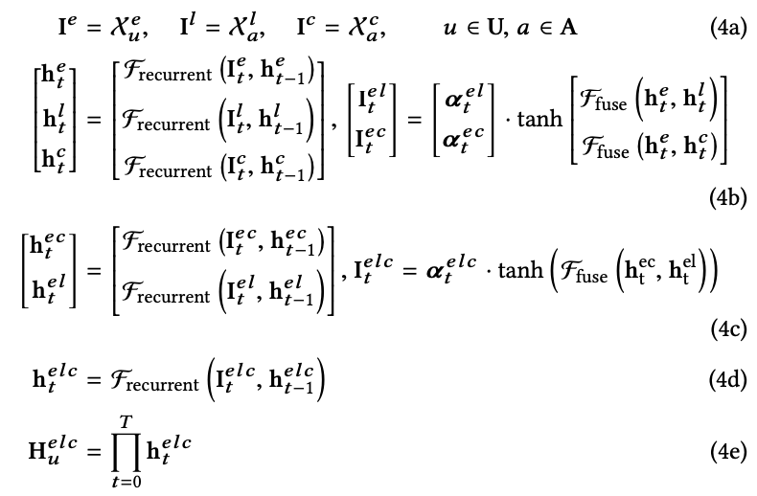
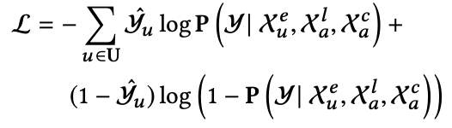
HEBR: Hierarchical Electricity-theft Behavior Recognition
Formulation and Learning
Binary cross-entropy loss:
Notes:
So far, we can give complete mathematical formulations of HEBR, where multi-source sequences initialize the input I , then three levels of feature extraction and hierarchical fusion are conducted. The last fused representations acting as feature embeddings, are maped into a binary vector, and then be turned into the probability of electricity theft. We can use the Adam optimizer for the parameter learning, and reduce the binary cross-entropy loss.

Slide 15
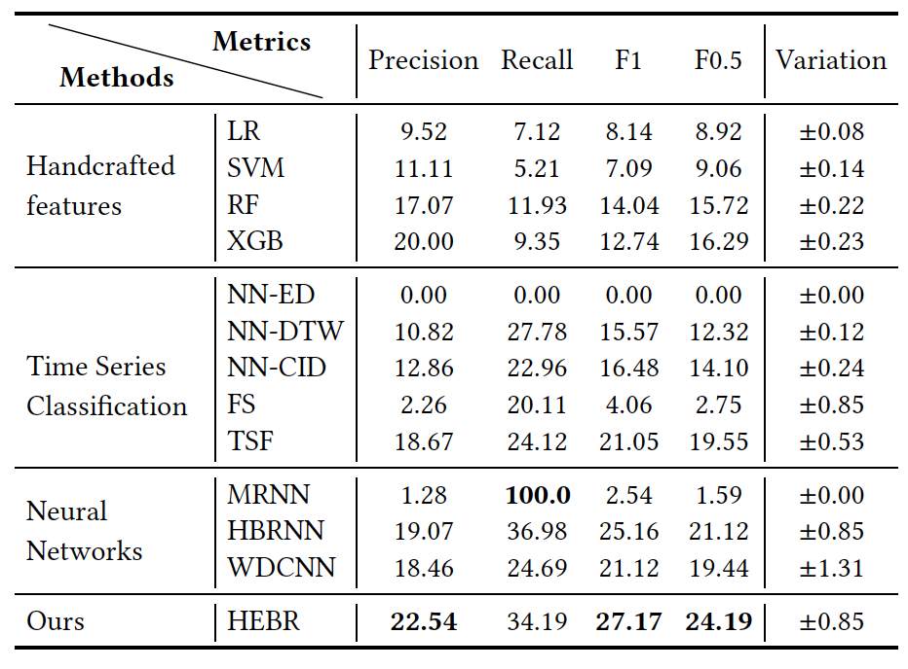
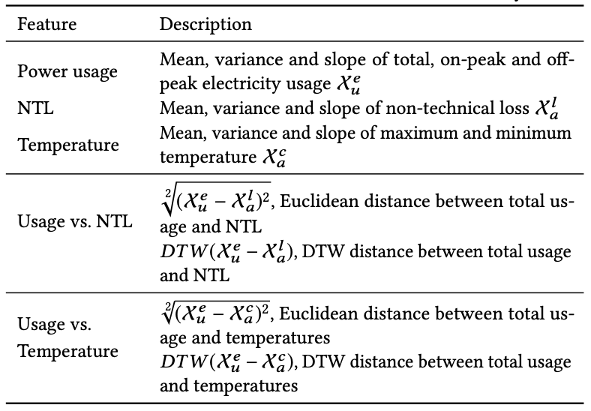
Experiments
Baseline methods
Handcrafted features
Notes:
We conduct experiments on the real-world dataset to validate the model effectiveness.
We consider the following benchmark methods. The first type is classification methods based on handcrafted features, which have been commonly used in existing work on electricity theft detection. The features are shown in the table and we use some famous algorithms as classifier

Slide 16
Experiments
Baseline methods
Handcrafted features
Time Series classification^{[1][2] [3] [4]}
Neural Networks ^{[6][7] [8]}
HEBR(Our approach)
[1] Donald J and James C. 1994. Using dynamic time warping to find
patterns in time series. SIGKDD (1994)
[2] Gustavo EAPA B, Xiaoyue W, and Eamonn J K 2011. A complexityinvariant
distance measure for time series. SDM (2011
[3] Thanawin R and Eamonn K. 2013. Fast shapelets: A scalable algorithm for discovering time series shapelets. ICDM (2013)
[4] Houtao D, George R, Eugene T, and Martyanov V 2013. A time series forest for classification and feature extraction. Information Sciences 239 (2013)
[5] Alex G, Abdelrahman M, and Geoffrey E H. [n.d.]. Speech recognition with deep recurrent neural networks. International Conference on Acoustics, Speech, and Signal Processing (ICASSP)
[6] Alex G, Abdelrahman M, and Geoffrey E H. [n.d.]. Speech recognition with deep recurrent neural networks. (ICASSP)
[7] Yong D, Wei W, and Liang W. 2015. Hierarchical recurrent neural network for skeleton based action recognition. In Proceedings of the IEEE conference
on computer vision and pattern recognition
[8] Zibin Z Yatao Y, Xiangdong N, Hong-Ning D, and Yuren Z 2017. Wide and deep convolutional neural networks for electricity-theft detection to secure smart grids. IEEE Transactions on Industrial Informatics 14, 4 (2017)
Notes:
The second type of baseline is time series classification methods, including: nearest neighbor methods, fast shaplets, and Time Series Forest.
The third type of baseline, we consider several competitive deep learning methodologies
And last is our method.

Slide 17
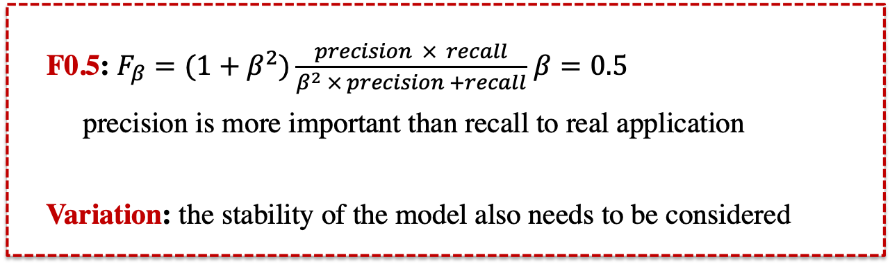
Experiments
F0.5: $F_{β}=(1+β^{2})\frac{precision × recall}{β^{2} × precision +recall}$ $β=0.5$
precision is more important than recall to real application
Variation: the stability of the model also needs to be considered
Notes:
We use precision, recall and two F-measures (F1, F0.5) as metrics. Here, we prefer to use F0.5 as the metric for electricity-theft detection, as precision is more important than recall to real application.
We also present the standard deviation to compare the stability of different models

Slide 18
Experiments
Notes:
As the shown in the table, as expected, HEBR are better able to handle multi-source data and consequently outperform other methods.

Slide 19
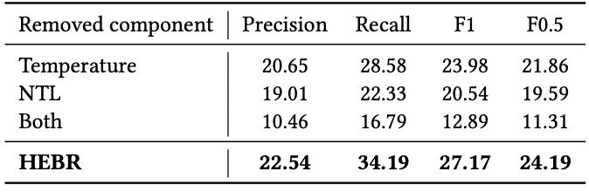
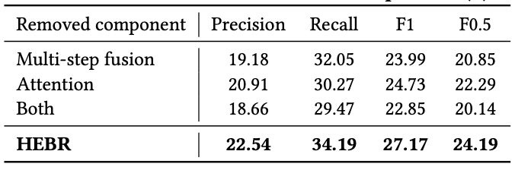
Effectiveness Validation
Several ablation studies are conducted to validate the model effectiveness
Effect of multi-source information
Effect of fusion and attention operators
Notes:
In order to further validate the model effectiveness, we conduct several ablation studies. We test the performance by removing some components in the model.
First, we remove the input sequences of temperature or NTL, or both of them, find that the performance will drop substantially.
Then, we remove some operators in turn and assess the subsequent impact on performance. The results suggest that these two operators, multi-step fusion and temporal attention, work well together to bridge the information from different sources

Slide 20
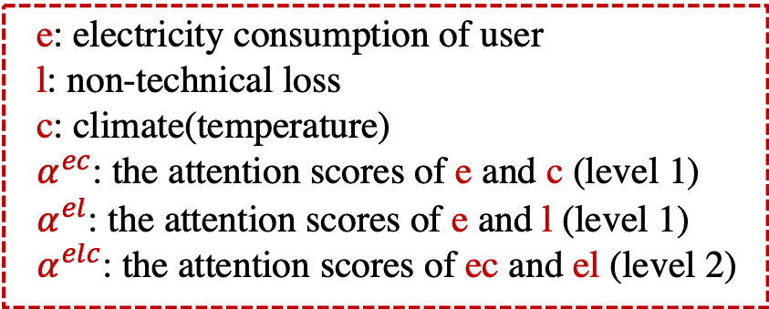
Real World Application
Our work has been applied by State Grid of China to successfully catch electricity thieves in Hangzhou with a precision of 15%
when the thief was caught
e: electricity consumption of user
l: non-technical loss
c: climate(temperature)
$α^{ec}$: the attention scores of e and c (level 1)
$α^{el}$: the attention scores of e and l (level 1)
$α^{elc}$: the attention scores of ec and el (level 2)
Notes:
Apart from the experiments, we also applied our HEBR model to detect electricity theft, in cooperation with State Grid of China. It turned out that HEBR detected three electricity thieves out of 20 with 15% precision in practice, which represented a significant improvement in on-site investigation precision.
There is a specific example, red bar indicate the time when the thief was caught. We visualized the attention scores at different levels.

Slide 21
Real World Application
Our work has been applied by State Grid of China to successfully catch electricity thieves in Hangzhou with a precision of 15%
when the thief was caught
Notes:
And we can see that the high-scoring positions, the brighter areas of the heat map, are where the electricity usages are low, along with hot weather and high non-technical loss.
It is consistent with previous empirical observation.

Slide 22
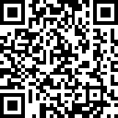
Conclusions
Analyze electricity-theft behaviors from three distinct levels of information based on multi-source data;
Propose the Hierarchical Electricity-theft Behavior Recognition (HEBR) model based on observational studies, which identifies electricity theft by fusing different levels of information, and validate its effectiveness using a real-world dataset;
Apply HEBR to catch electricity thieves on-site and achieve significant performance improvements.
THANKS |
Released codes: https://github.com/zjunet/HEBR
More relevant research of our group: http://yangy.org
Contact: yangya@zju.edu.cn
Q&A
Notes:
Finally let me summarize our work. We study an important problem: electricity-theft detection via multi-source data.
We analyze the illegal behaviors based on the multi-source data. And then propose the HEBR model, which identifies electricity theft by fusing different levels of information. We also conduct sufficient experiments and applications to validate the effectiveness of our model.
Lastly, We hope that our study can encourage more researchers to examine this important problem.

